Slide 1

Text Vectorization
From texts to numbers!

Slide 2
Text vectorization
Text vectorization is a crucial concept in Natural Language Processing (NLP) that involves converting text data into numerical representations, or vectors, so that machine learning algorithms can process and analyze it.
Why Vectorization
Machine Learning Compatibility: Most machine learning algorithms work with numerical data. Text, being inherently non-numeric, needs to be transformed into a format that these algorithms can understand.
Capturing Meaning: Vectorization helps in capturing the semantic meaning of words and phrases, allowing models to understand relationships and context.

Slide 3
Common Methods of Text Vectorization
Bag of Words (BoW)
Term Frequency-Inverse Document Frequency (TF-IDF)
Word Embeddings

Slide 4
Bag of Words (BoW)
Concept: This method represents text as a collection of words, disregarding grammar and word order but keeping track of the frequency of each word.
Example: For the sentences "I love cats" and "I love dogs", the vocabulary would be ["I", "love", "cats", "dogs"]. The sentences would be represented as:
"I love cats" → [1, 1, 1, 0]
"I love dogs" → [1, 1, 0, 1]

Slide 5
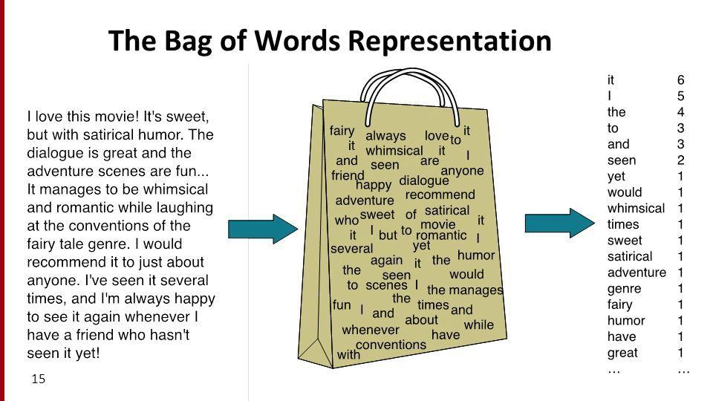

Slide 6
BoW
A more comprehensive example of the Bag of Words (BoW) model using multiple sentences and a larger vocabulary.
Example Sentences
"The cat sat on the mat."
"The dog barked at the cat."
"Cats and dogs are great pets."
"I love my cat."
"Dogs are loyal animals."

Slide 7
BoW
Step 1: Create a Vocabulary
First, we need to identify the unique words in all the sentences. The vocabulary will include all distinct words, ignoring case and punctuation.
Vocabulary:
"the"
"cat"
"sat"
"on"
"mat"
"dog"
"barked"
"at"
"and"
"dogs"
"are"
"great"
"pets"
"I"
"love"
"my"
"loyal"
"animals"

Slide 8
BoW
Vector Representation
Next, we will represent each sentence as a vector based on the vocabulary. Each position in the vector corresponds to a word in the vocabulary, and the value at that position indicates the frequency of that word in the sentence.
Vector Representation:
"The cat sat on the mat.". Vector: [2, 1, 1, 1, 1, 0, 0, 0, 0, 0, 0, 0, 0, 0, 0, 0, 0]
"The dog barked at the cat.". Vector: [2, 1, 0, 0, 0, 1, 1, 1, 0, 0, 0, 0, 0, 0, 0, 0, 0]
"Cats and dogs are great pets." Vector: [0, 0, 0, 0, 0, 1, 0, 0, 1, 1, 1, 1, 1, 0, 0, 0, 0]
"I love my cat." Vector: [0, 1, 0, 0, 0, 0, 0, 0, 0, 0, 0, 0, 0, 1, 1, 0, 0]
"Dogs are loyal animals." Vector: [0, 0, 0, 0, 0, 1, 0, 0, 0, 0, 1, 0, 0, 0, 0, 1, 1]

Slide 9
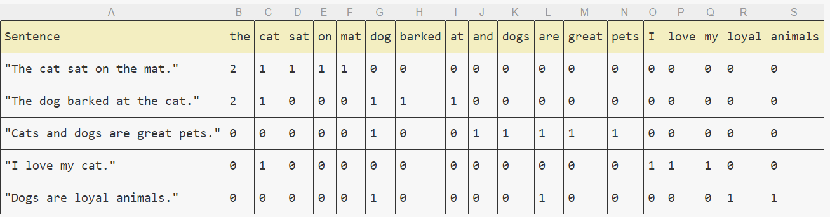
BoW matrix

Slide 10
Term Frequency-Inverse Document Frequency (TF-IDF)
Concept: This method not only considers the frequency of words in a document but also how common or rare they are across all documents. It helps to highlight important words.
Formula: TF-IDF = (Term Frequency) * (Inverse Document Frequency)
Use Case: It’s useful for identifying the importance of words in a document relative to a collection of documents.

Slide 11
TF IDF example
Example Documents
Let's consider the following three documents:
Document 1: "The cat sat on the mat."
Document 2: "The dog barked at the cat."
Document 3: "Cats and dogs are great pets."

Slide 12
TF IDF example
Step 1: Calculate Term Frequency (TF)
Term Frequency (TF) is the number of times a term appears in a document divided by the total number of terms in that document.
Document 1:
Total words = 7
TF for each word:
the: 2/7
cat: 1/7
sat: 1/7
on: 1/7
mat: 1/7
Document 2:
Total words = 7
TF for each word:
the: 2/7
dog: 1/7
barked: 1/7
at: 1/7
cat: 1/7
Document 3:
Total words = 6
TF for each word:
cats: 1/6
and: 1/6
dogs: 1/6
are: 1/6
great: 1/6
pets: 1/6

Slide 13
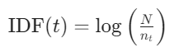
TF IDF example
Step 2: Calculate Inverse Document Frequency (IDF)
Inverse Document Frequency (IDF) measures how important a term is across all documents. It is calculated as:
Where:
N = total number of documents
Nt= number of documents containing the term t
Total documents N=3

Slide 14
Tf idf calculation
the: Appears in 2 documents → IDF = log(3/2)≈0.176
cat: Appears in 2 documents → IDF = log(3/2)≈0.176
sat: Appears in 1 document → IDF = log(3/1)≈1.099
on: Appears in 1 document → IDF = log(3/1)≈1.099
mat: Appears in 1 document → IDF = log(3/1)≈1.099
dog: Appears in 1 document → IDF = log(3/1)≈1.099
barked: Appears in 1 document → IDF = log(3/1)≈1.099
at: Appears in 1 document → IDF = log(3/1)≈1.099
cats: Appears in 1 document → IDF = log(3/1)≈1.099
and: Appears in 1 document → IDF = log(3/1)≈1.099
dogs: Appears in 1 document → IDF = log(3/1)≈1.099
are: Appears in 1 document → IDF = log(3/1)≈1.099
great: Appears in 1 document → IDF = log(3/1)≈1.099
pets: Appears in 1 document → IDF = log(3/1)≈1.099

Slide 15
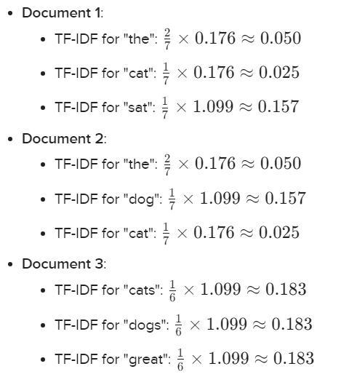
Calculate TF-IDF
Step 3: Calculate TF-IDF
Now, we can calculate the TF-IDF for each term in each document by multiplying the TF and IDF values.

Slide 16
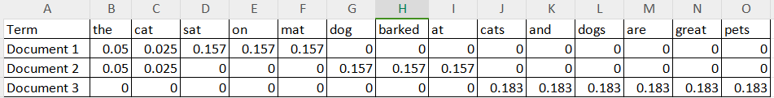
Final TF-IDF Matrix

Slide 17
N-Gram representation
N-gram representation is a technique used in natural language processing (NLP) and text analysis to break down text into smaller, contiguous sequences of items, typically words or characters. The "N" in "N-gram" refers to the number of items in each sequence.

Slide 18
Example
"I love natural language processing because it allows computers to understand human language better."
Unigrams (1-grams): ["I", "love", "natural", "language", "processing", "because", "it", "allows", "computers", "to", "understand", "human", "language", "better"]
Bigrams (2-grams): ["I love", "love natural", "natural language", "language processing", "processing because", "because it", "it allows", "allows computers", "computers to", "to understand", "understand human", "human language", "language better"]
Trigrams (3-grams): ["I love natural", "love natural language", "natural language processing", "language processing because", "processing because it", "because it allows", "it allows computers", "allows computers to", "computers to understand", "to understand human", "understand human language", "human language better"]

Slide 19
Ngram adv vs Disadvantages
Advantages:
Captures local context: N-grams can capture the context of words in a sentence, which is important for understanding meaning.
Simplicity: The concept is straightforward and easy to implement.
Disadvantages:
Sparsity: As N increases, the number of possible N-grams grows exponentially, leading to sparsity in the data.
Loss of long-range dependencies: N-grams only consider local context, which may miss relationships between words that are far apart in the text.

Slide 20
Word Embeddings
Concept: Unlike BoW and TF-IDF, word embeddings represent words in a continuous vector space where semantically similar words are closer together. This captures more context and meaning.
Examples:
Word2Vec: Trained on large corpora to create dense vector representations of words.
GloVe: Global Vectors for Word Representation, which captures global statistical information.

Slide 21
Term-document matrix
Each document is represented by a vector of words
Notes:
Imagine we have a collection of documents, such as all the works of Shakespeare. We can represent documents in such a collection by a term-document matrix, in which each row represents a word in the vocabulary and each column represents a document from the collection. Here's a small selection from a term-document matrix showing the occurrence of four words in four plays by Shakespeare. Each cell in this matrix represents the number of times a particular word (defined by the row) occurs in a particular document (defined by the column). Thus fool appeared 58 times in Twelfth Night. We can think of each column as a vector representing for a document as a point in |V |-dimensional space; thus the documents in here are points in 4-dimensional space.

Slide 22
Visualizing document vectors
Notes:
A spatial visualization of the document vectors for the four Shakespeare play documents, showing just two of the dimensions, corresponding to the words battle and fool. The comedies have high values for the fool dimension and low values for the battle dimension.

Slide 23
word-word matrix (or "term-context matrix")
Two words are similar in meaning if their context vectors are similar
Notes:
An alternative to using the term-document matrix to represent words as vectors of document counts, is to use the term-term matrix, also called the word-word matrix or the term-context matrix, in which the columns are labeled by words rather than documents. This matrix is thus of dimensionality |V | × |V | and each cell records the number of times the row (target) word and the column (context) word co-occur in some context in some training corpus.
The context could be the document, in which case the cell represents the number of times the two words appear in the same document. It is most common, however, to use smaller contexts, generally a window around the word, for example of 4 words to the left and 4 words to the right, in which case the cell represents the number of times (in some training corpus) the column word occurs in such a ±4 word window around the row word. For example here is one example each of some words in their windows with counts from a Wikipedia corpus. Note that digital and information are more similar to each other than, say, to strawberry.

Slide 24
Notes:
Here's a spatial visualization of word vectors for digital and information, showing just two of the dimensions, corresponding to the words data and computer.
Of course in real life these vectors aren't just of length 2. |V |, the length of the vector, is generally the size of the vocabulary, of- ten between 10,000 and 50,000 words (using the most frequent words in the training corpus; keeping words after about the most frequent 50,000 or so is generally not helpful). Since most of these numbers are zero these are sparse vector representations; there are efficient algorithms for storing and computing with sparse matrices.

Slide 25
cosine for computing word similarity
Based on the definition of the dot product between two vectors a and b
Notes:
We modify the dot product to normalize for the vector length by dividing the dot product by the lengths of each of the two vectors. This normalized dot product turns out to be the same as the cosine of the angle between the two vectors (Geometrically, it is the product of the Euclidean magnitudes of the two vectors and the cosine of the angle between them).

Slide 26
Cosine examples
 | pie | data | computer
cherry | 442 | 8 | 2
digital | 5 | 1683 | 1670
information | 5 | 3982 | 3325
Notes:
Let’s see how the cosine computes which of the words cherry or digital is closer in meaning to information, just using raw counts from the following shortened table.
The model decides that information is way closer to digital than it is to cherry, a result that seems sensible.

Slide 27


QA
Thanks … Grazie … شكرا … Gracias … Merci … 谢谢 (Xièxiè)

